Slide 1
Video Compression - SBI
Powered By - Microsoft Corporation Pvt Ltd.

Slide 2

With the advent of Video Based Customer Identification Process (V-CIP), multiple use cases have emerged for customer onboarding & servicing requests of customers in a secure, paperless, cost-effective & friendly manner.
Storage / retrieval of these video files is a challenge especially given the expected tsunami of video files that are expected to be generated on extending more use-cases to our client base of over 45 crore customers.
Problem Being Solved

Slide 3
A common technique for compression is resizing, or reducing the resolution. This is because the higher the resolution of a video, the more information that is included in each frame. For example, a 1280×720 video has the potential for 921,600 pixels in each frame, assuming it's an i-frame
Approach taken to create the model

Slide 4
Prerequisites
Sample Video file for testing prototype.
Resolution of the final file.
Frames per second expected in the final file.
Hardware Test bench details

Slide 5
1- Frame send per sec are 15frames/sec
2- Sample video was of 10.06 MB
3- The final video compressed is of 7.08 MB
4- Video compressor tool used for compressing the video is adobe.
Any supporting assumptions functional requirements(FR) and non- functional reqiuemnets

Slide 6
My first step is to make sure that I carefully examine the pros and cons and what each of them can cause. Next, I contemplate the obstacles I or my team can face because of the cons. If they can create a hindrance to achieving targets, then the approach probably may not be effective. Then I consider how the pros are outweighing the cons and what positive results they can deliver. If they outdo the cons in terms of accomplishments, then I will prefer to pursue them and deal with the impediments as they come my way. Here cons are referred to the file size and optimization that is needed in video compression.
reason why your solution should be considered

Slide 7
https://github.com/Pal-Chat/Techgig_SBI_Hackathon.git
Source code (Github Repository Link)

Slide 8
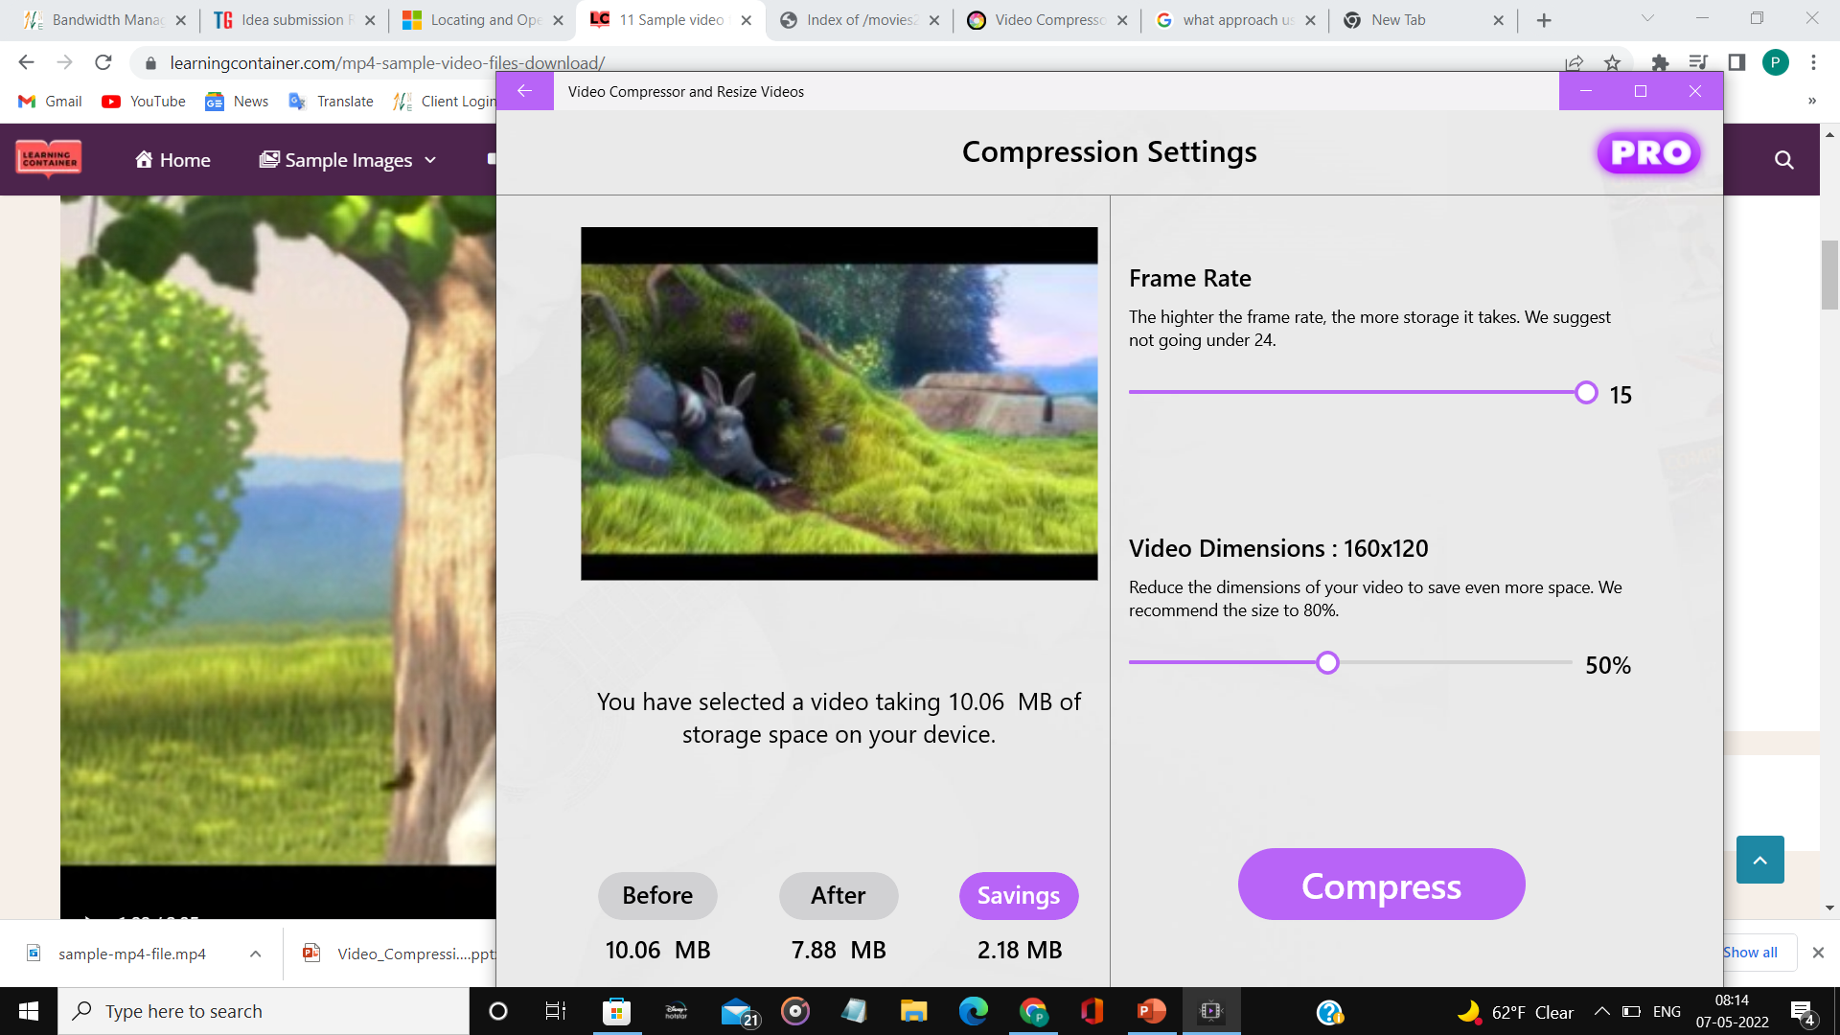
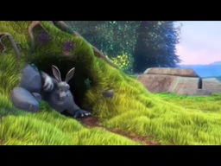
Demonstration Video showing the
functionalities/working of the solution.

Slide 9

Submitted By : Palak Chaturvedi
Email : p.chaturvedi1212@gmail.com
Mobile No: 8057606896

